Slide 1
OpenEdu Team C
19 NOV 2022
Agenda
01 Introduction
02 Methods & Techniques
03 Conclusion
Meet the team
Context & Users' needs
Solutions
Ontology & Data Modelling
NLP & Dummy UI
Visual Prototype
Next Steps
Our Learning Experiences
Q & A

Slide 2
01 Introduction

Slide 3
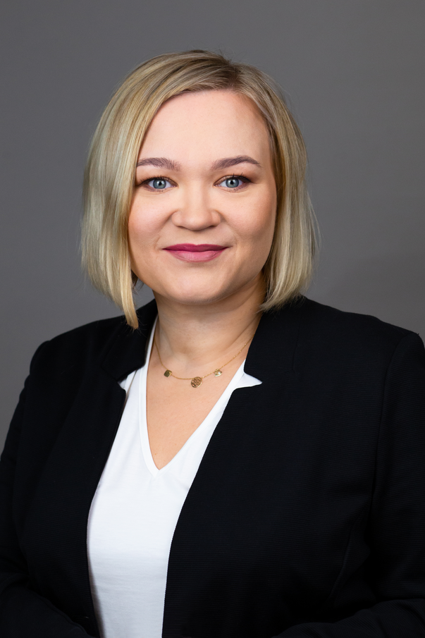
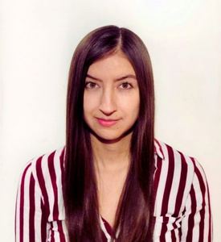
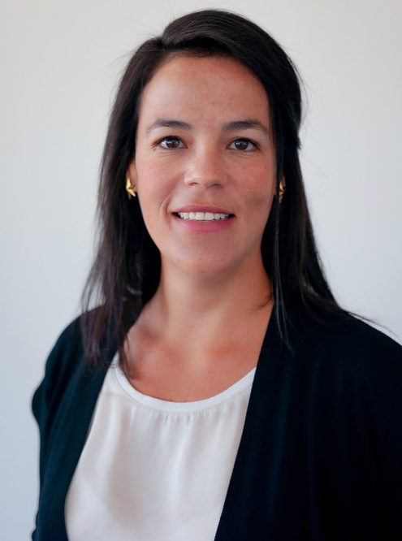



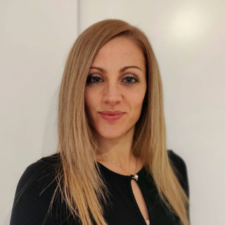
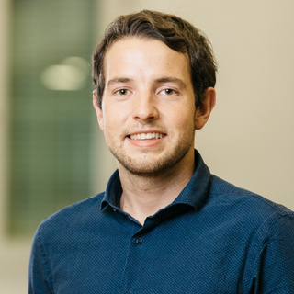
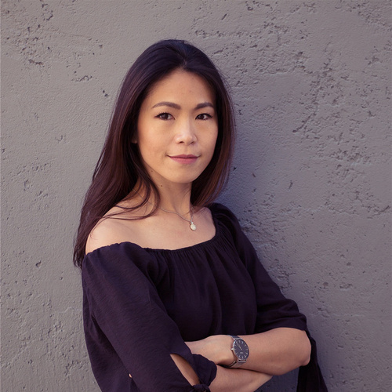



OpenEdu Team C
19 NOV 2022
Our Team
Iwona Braun-Nowak
Marcela Rozo
Daniela Pavia Santolamazza
Project Manager
PM Deputy
Data Scientist
Claudia Porcellato
Kevin Zihlmann
Carol Hsu
Data Scientist
Data Scientist
Backend/UI

Slide 4

OpenEdu Team C
19 NOV 2022
Context & Problems
Usability
User cannot find information, resources or educational materials on the website
User
Experience
Information overload on the webpage creates cognitive loading to end users
Value Proposition
Unclear message, target audience and offers of the website

Slide 5

OpenEdu Team C
19 NOV 2022
User Needs
KEY OBJECTIVE
Reducing user cognitive load and improving usability of the website based on the existing resources

Slide 6

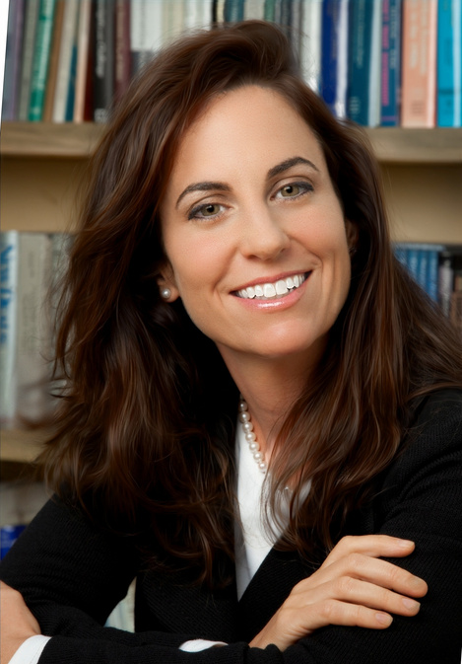
OpenEdu Team C
19 NOV 2022
Personas
Peter Meier
Teacher/Swiss/30
Simona Martin
Professor/ German/ 45
Passionate about Computer Science and System engineering.
Professional in Business Psychology passionate about people and professional training.
Peter enjoys teaching students in vocational school and encourages young students to learn programming languages in easy and fun ways.
Simona often got invited to workshops or webinars to give speeches about people development. Apart from her work, she is a member of WIKIMEDIA foundation and contributes on people training and management
pain
Finding suitable resource is a hassle
Overwhelmed with the abundance of information online
pain
Difficult to find course material for adult training since people have different backgrounds
Too many resources and too many duplicates content on internet

Slide 7
OpenEdu Team C
19 NOV 2022
Solutions
Solution 1
Solution 2
Solution 3
Developing an ontology that gives domain of the database that can help further data collection and data processing
Optimising existing features on the website: Search and related projects
Improving user experience by reducing information overload on landing page and uploading process

Slide 8
02
Methods & Techniques

Slide 9
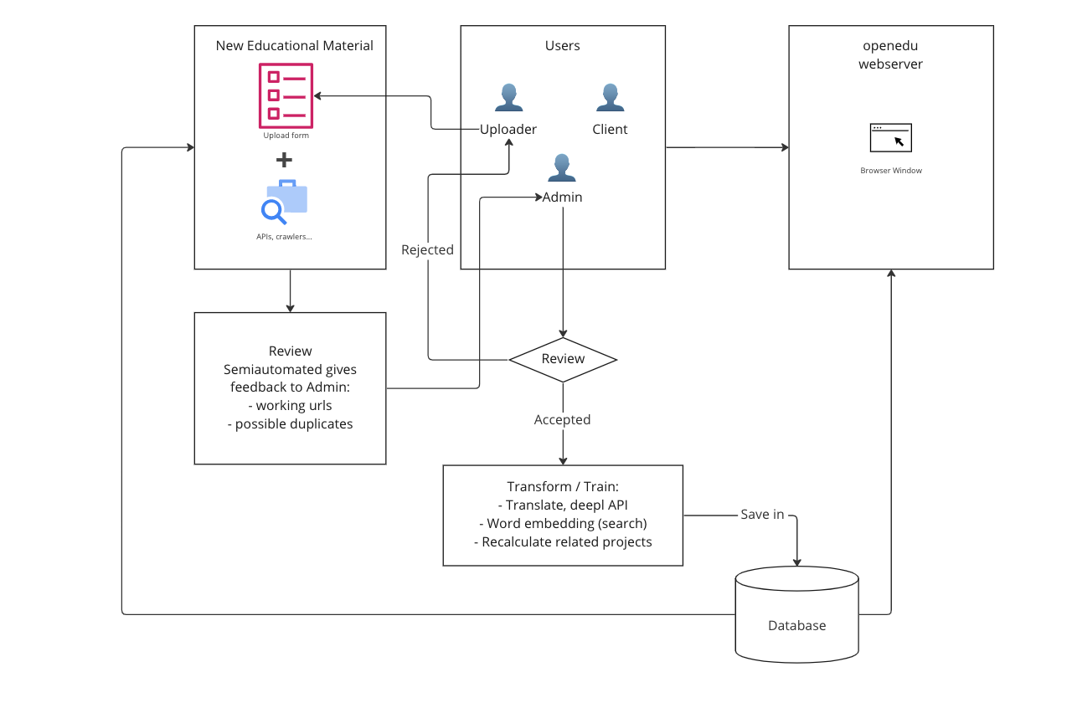
OpenEdu Team C
19 NOV 2022
Data Pipeline

Slide 10
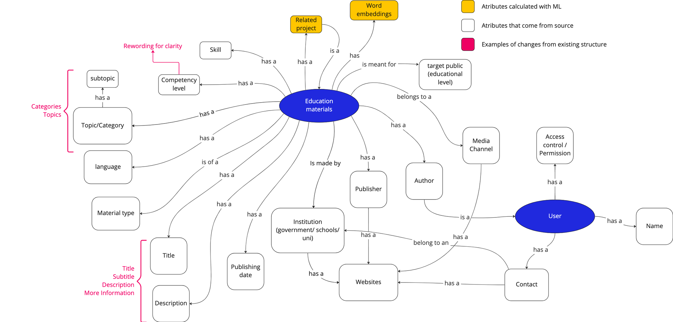
OpenEdu Team C
19 NOV 2022
Ontology

Slide 11






OpenEdu Team C
19 NOV 2022
Searching and finding related content with NLP
Initial problems of openedu.ch
Looking for solutions
Final solution: SBERT Model
Calculate the cosine similarity score
Loading pre-
trained model
Preprocessing
text
Compute the embedding of two texts to compare
Show similar contents

Slide 12
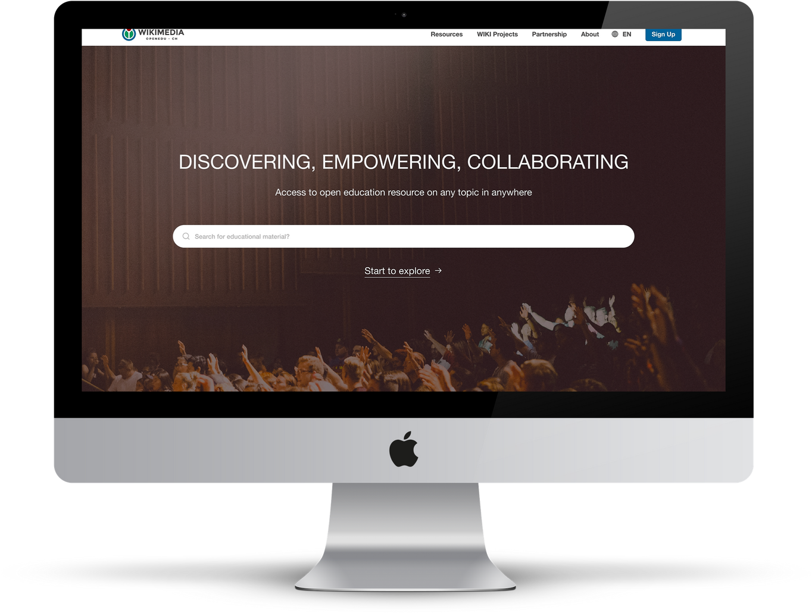


OpenEdu Team C
19 NOV 2022
Mental Model in UX
94
%
First impression is design-related
90
%
Users use the search box to find specific content
Process
Can help the user to complete their tasks

Slide 13
DEMO

Slide 14
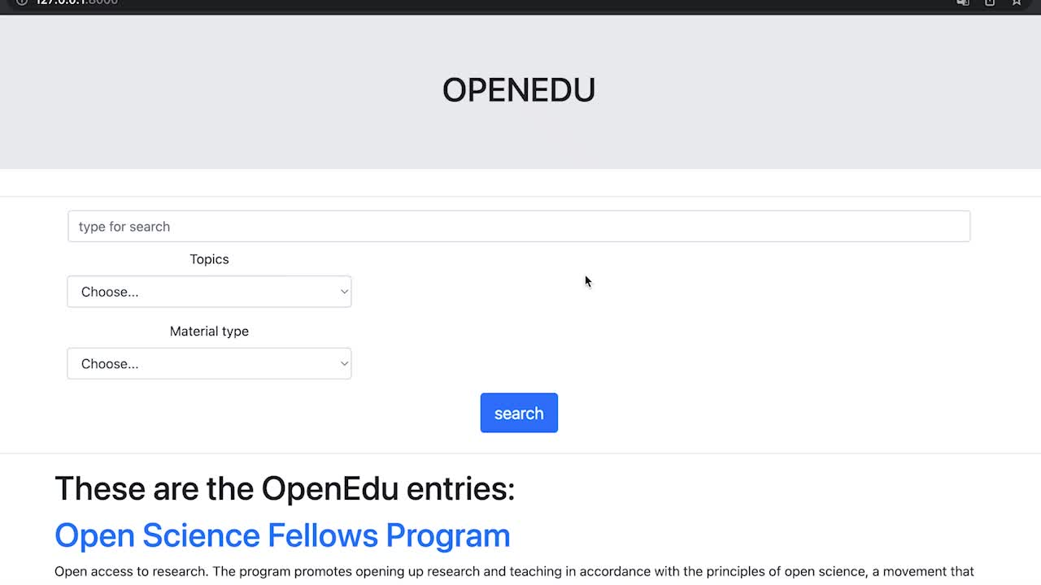

Slide 15
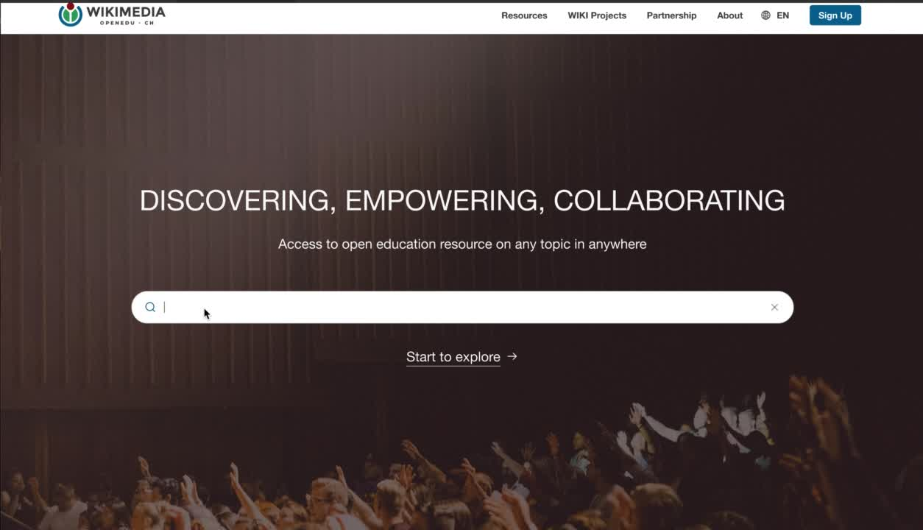

Slide 16
03
What' s Next?

Slide 17





OpenEdu Team C
19 NOV 2022
Future Roadmap
Here
we are
Data Collection
Build Connection
Automation
Nov 2022
Dec 2022
Feb 2023
Apr 2023

Slide 18
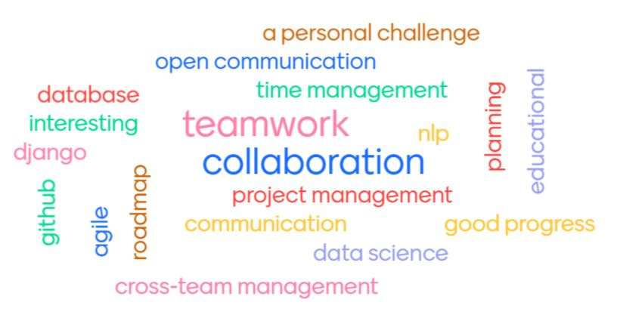
OpenEdu Team C
19 NOV 2022
Our individual & collective
learning experience

Slide 19










OpenEdu Team C
19 NOV 2022
Thank you.

Slide 20

OpenEdu Team C
19 NOV 2022
Q&A

Slide 21



OpenEdu Team C
19 Nov 2022
User Journey
Need to make a course plan, prepare a speech or workshop
Platforms they already used
Search in Google
Ask a colleague
Gathering all sources
Discussing with colleagues or management
Select suitable course materials
Make a lesson plan
Receiving feedback from students
Asking for peer review or sharing work with others
user Action
Aware
Explore
Evaluation
Decide
Advocacy
Touchpoint
School, university, workplace
Internet or colleagues
Institution
colleagues
Digital WOM
colleagues
Students, colleagues, feedbacks WOM

Slide 22
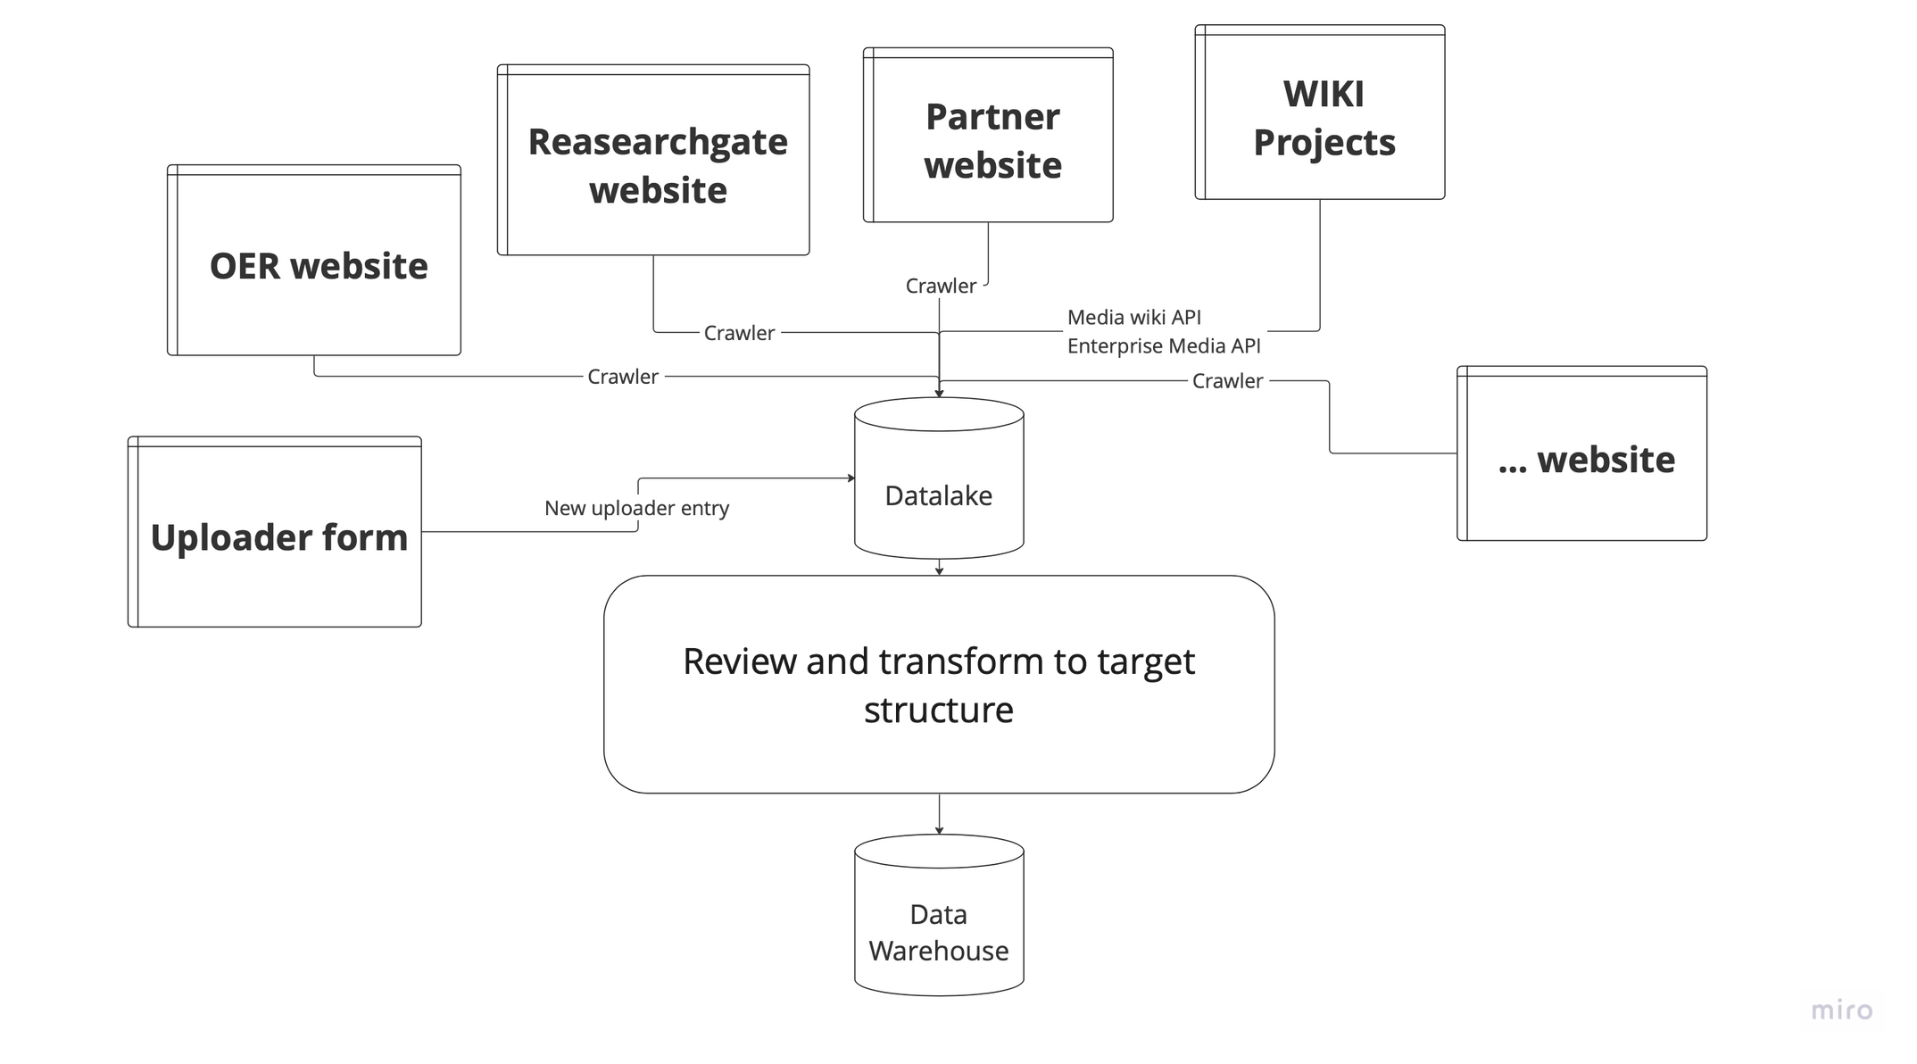
OpenEdu Team C
19 NOV 2022

